Slide 1
HTML5 Forms

Slide 2
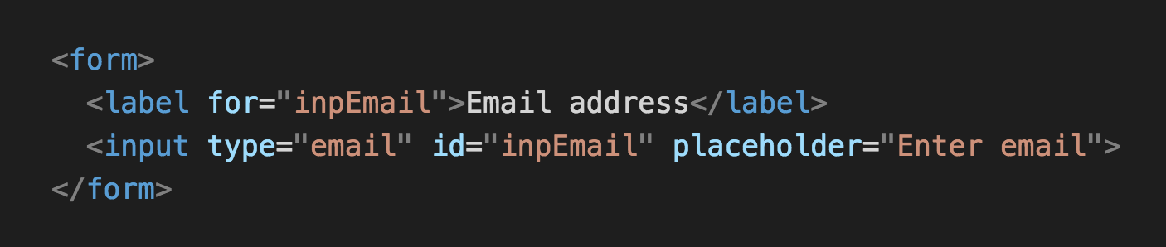

Slide 3
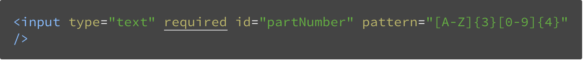
url | datetime
tel | datetime-local
email | date
search | time
number | week
color | month
range
Forces user to enter data for this field
Attributes

Slide 4


Slide 5
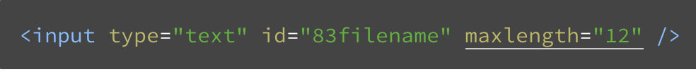

The maxlength attribute

Slide 6
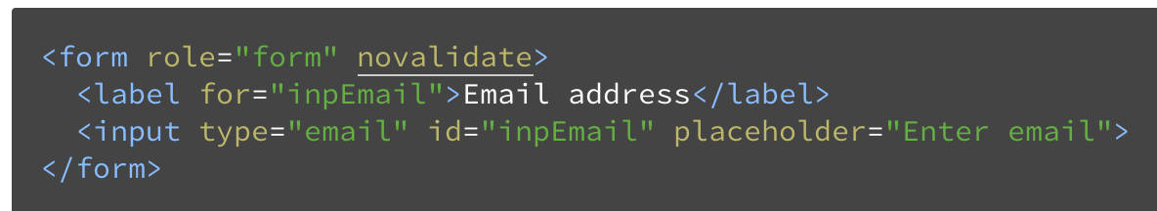
Allow the user to submit the form even if it contains invalid input.

Slide 7
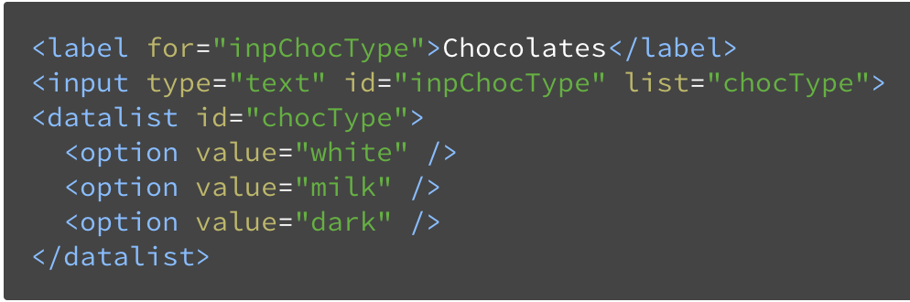
The datalist element
Unlike select elements where users must scan long lists to find the value they’re looking for, and limiting them only to those lists, datalists provide hints as the user types.

Slide 8
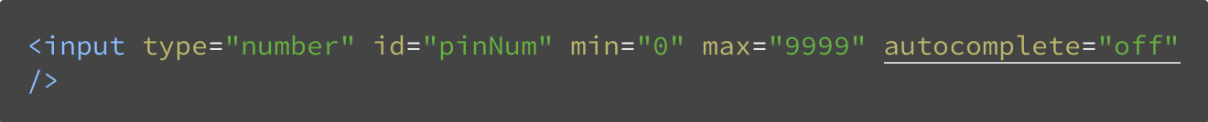

Slide 9
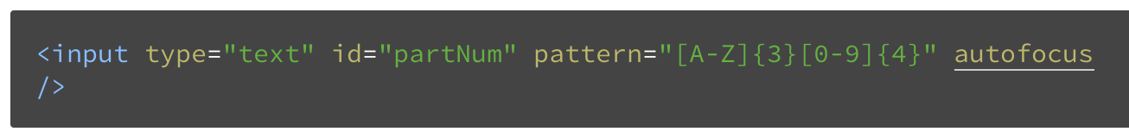
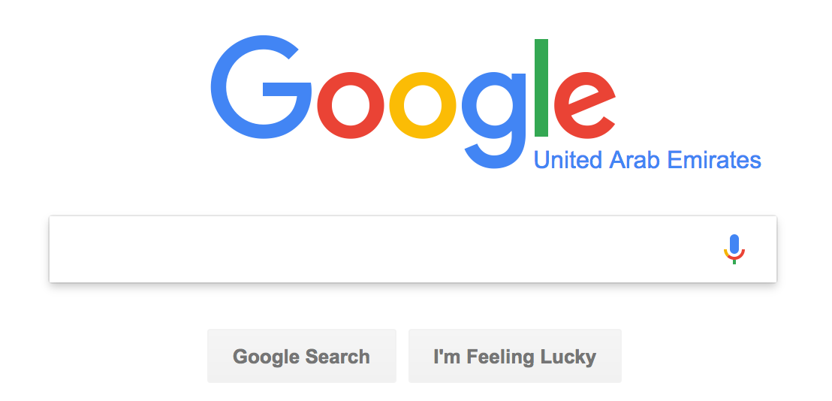
The autofocus attribute

Slide 10
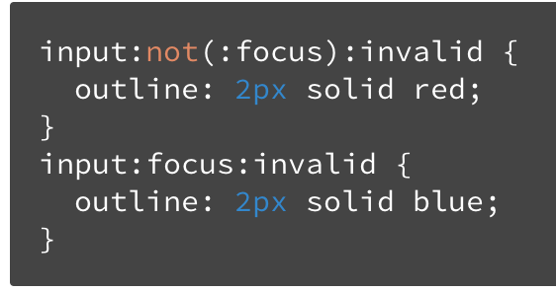
Styling with CSS3

Slide 11
Thank you

